Slide 1
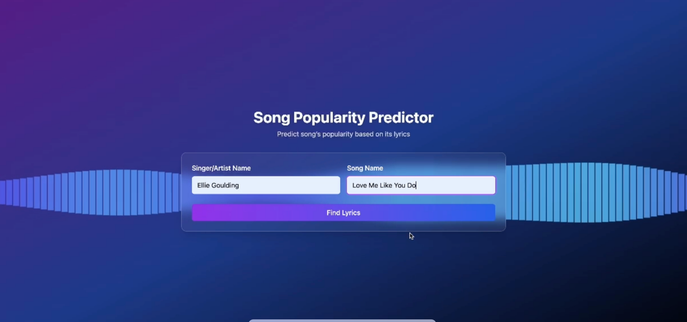

Slide 2





MUSIC SUCCESS
PREDICTION
Kush Ashesh Shah
Dhvanil Sanjay Shah
Hardik Prakashbhai Shah
Adélie Plumasseau
Notes:
The objective of this project is to predict whether a song will be a commercial success (i.e., charting on platforms like Billboard Hot 100) based on the analysis of its lyrics. The project aims to explore the relationship between lyrical content (language style, sentiment, themes, and complexity) and the success of a song. By using natural language processing (NLP) techniques to understand song lyrics, we aim to predict which songs have the potential to become hits.

Slide 3
Problem Statement
CLASSIFYING
HIT
SONGS
Can we predict song popularity based on lyrics ?
Can lyrical patterns optimize songwriting, marketing, and music recommendations?
Can songwriters, producers, and streaming platforms benefit from AI-driven insights?

Slide 4
Business Objectives
Music Producers & Labels
They can use AI insights to spot potential hits before investing in production and marketing.
WHO
Benefits
FROM THIS
PROJECT?
Marketing & Promotion Teams
They can tailor campaigns based on lyrical trends that resonate with audiences.
Streaming Platforms (Spotify, Apple Music)
Personalized playlists and AI-driven recommendations can improve based on lyrical patterns.
Independent Artists
Up-and-coming musicians can analyze trends to craft lyrics that increase their chances of success.

Slide 5
Overview
Can we predict song popularity based on lyrics using NLP & ML?
To answer this, we structured our project into 6 sections:
Data Collection & Preprocessing 🏗️
Feature Engineering 🎵
Model Selection and Training
Result & Performance Analysis 📊
Challenges & Limitations ⚠️
Demo!! 🚀🎶

Slide 6
Data Collection & Preprocessing 🏗️
Methodology 🔍
Deduplicated Records: Grouped by Song & Performer, using mode for categorical & mean for numeric features.
Feature Selection: Removed irrelevant columns and merged tables on SongID.
Lyrics Collection: Built a multi-threaded scraper to fetch lyrics.
Applied lower casing, treated non-alphabetic characters , filtered lyrical tags, handaled contractions, and remove stop words.
📊 Dataset: Billboard Hot weekly charts
🚀 Goal: Ensure high-quality, structured data for accurate NLP modeling.

Slide 7
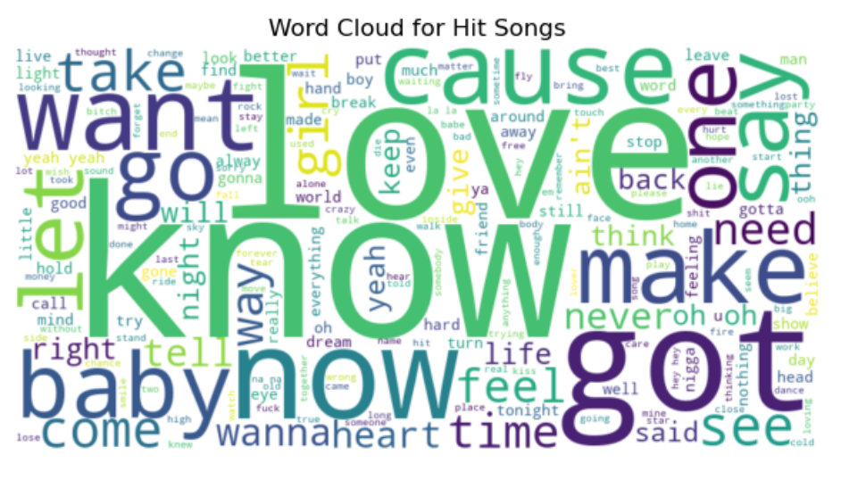
Feature Engineering 🎵
Word2Vec: Captured word relationships through context.
TF-IDF: Ranked word importance based on frequency.
Sentiment Analysis & Word Patterns: Analyzed emotions and lyrical complexity.
Words like "know," "got," "one," "love" appear prominently in both hit and non-hit songs, indicating their widespread usage in song lyrics.

Slide 8
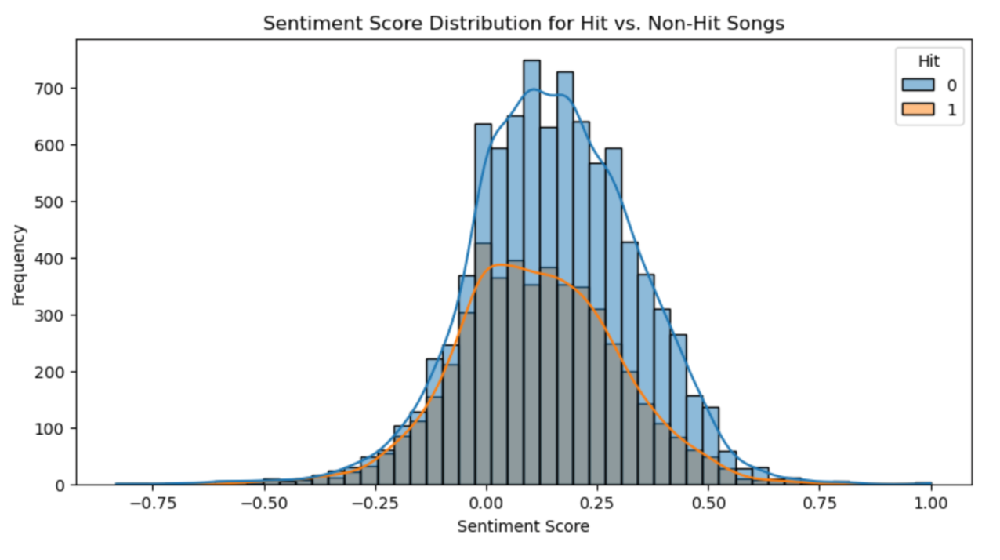
Feature Engineering 🎵
Word2Vec: Captured word relationships through context.
TF-IDF: Ranked word importance based on frequency.
Sentiment Analysis & Word Patterns: Analyzed emotions and lyrical complexity.
Balanced Sentiment: Most songs, whether hits or non-hits, have neutral sentiment scores
Lack of Extreme Sentiments: Very negative (< -0.5) or highly positive (> 0.5) lyrics are uncommon in both categories

Slide 9
Model Selection & Training
Model | Accuracy | Strength 💡 | Limitation ⚠️
LSTM 🏆 | 64% | Best for sequential text & context learning. | Needs large dataset, struggles with short lyrics.
Random Forest | 60.5% | Works well with structured data and ensures an ensemble approach. | Doesn’t understand word order.
SVM | 62.3% | Good for text classification (TF-IDF, Word2Vec). | Struggles with complex, long sequences.
XGBoost | 61% | Strong on structured features. | Not ideal for lyrics-based NLP.
AutoGluon 🏆 | 72.2% | Best performer—automates model tuning & combines multiple approaches. | No major downside!
LSTM (Best for sequences, captures context).
Random Forest (Structured feature analysis).
AutoGluon (Best accuracy, automates optimization).

Slide 10
Results & Performance Analysis 📊
LSTM captures lyrical sequence but with slightly lower accuracy.
✅ Song Structure Insights:
Highly repetitive lyrics → more likely to be a hit.
Emotionally positive songs → slightly more likely to be a hit.
✅ Unexpected Findings:
Word count doesn’t significantly impact success.
Sentiment alone isn’t a strong indicator of a hit song.
AutoGluon
72.2% Accuracy
LSTM
64% Accuracy
Random Forest: 60.5% Accuracy
SVM: 62.3% Accuracy
XGBoost: 61% Accuracy

Slide 11
Challenges & Limitations ⚠️
Challenge:
Our model only analyzes lyrics, but song success depends on many factors—production, marketing, artist reputation, and trends.
Music Success is NOT Just About Lyrics!
Limitation:
Success is subjective, so we need to consider cultural, emotional, and industry influences beyond text analysis.

Slide 12

Demo!! 🚀

Slide 13
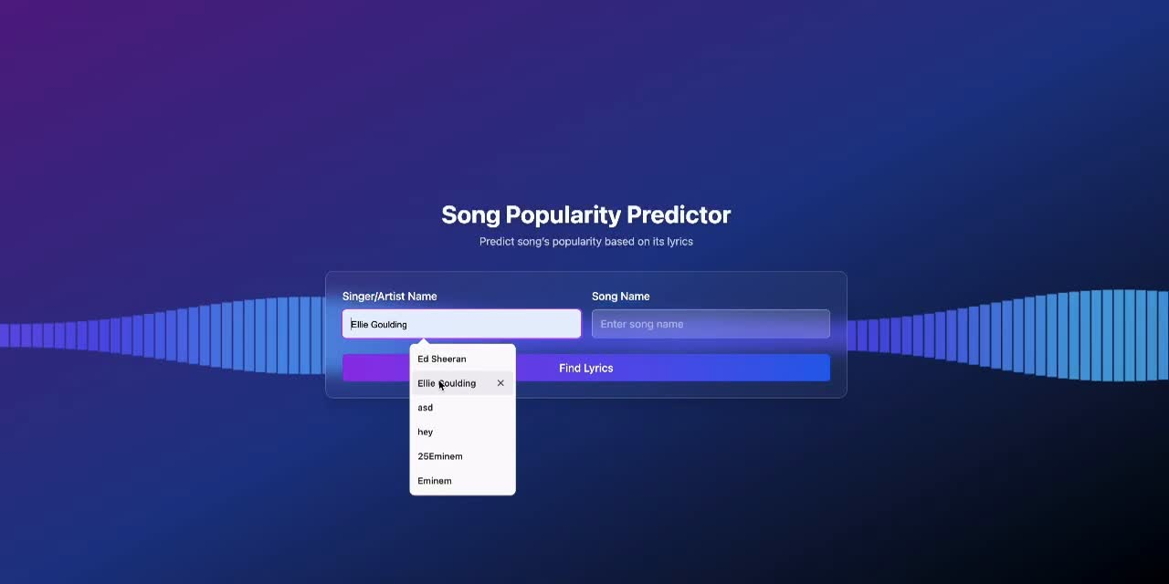

Slide 14
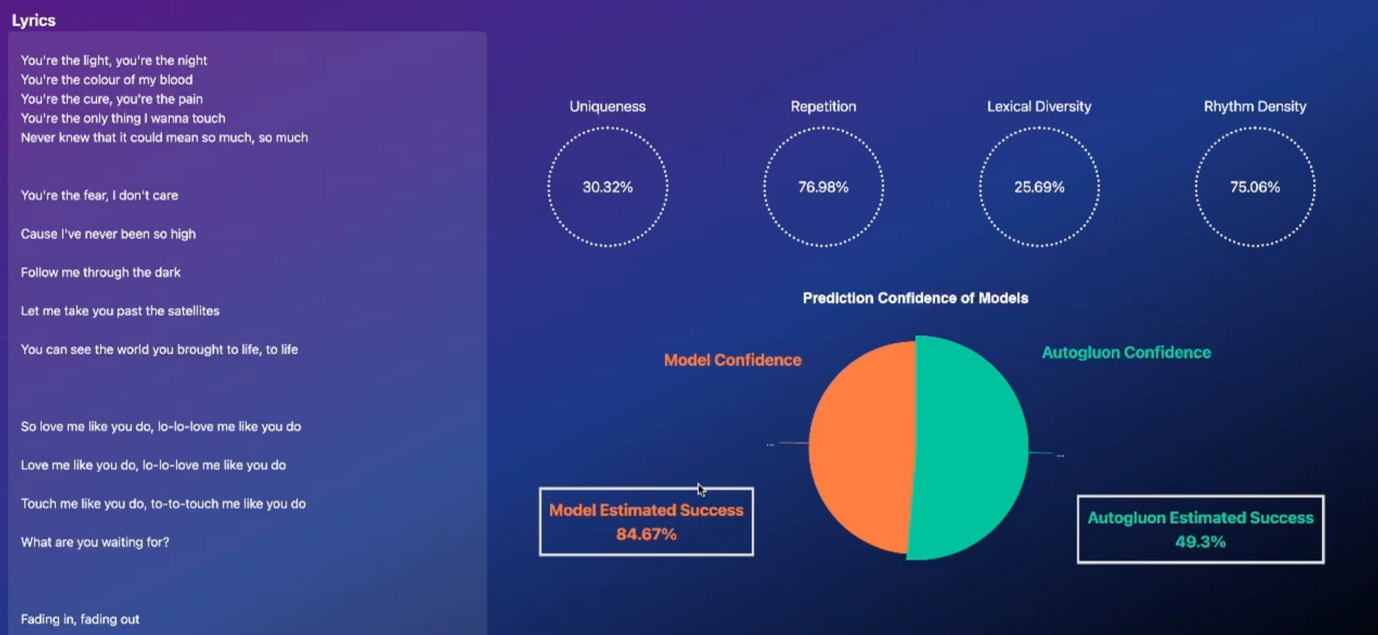

Slide 15
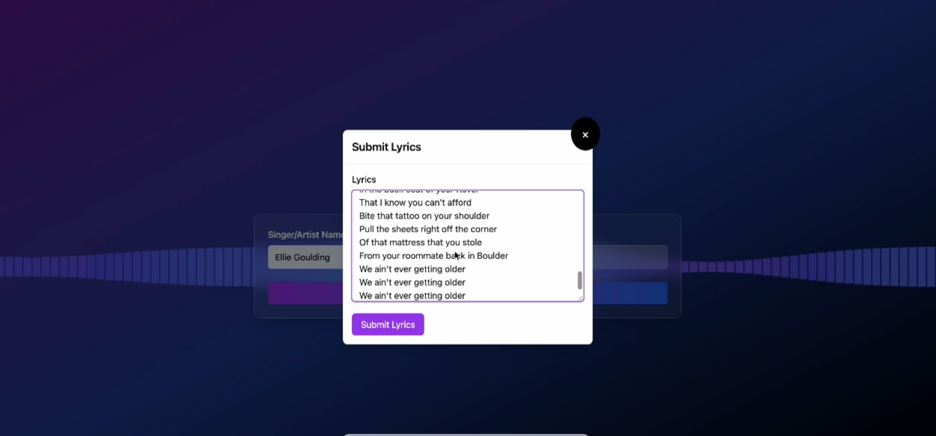

Slide 16
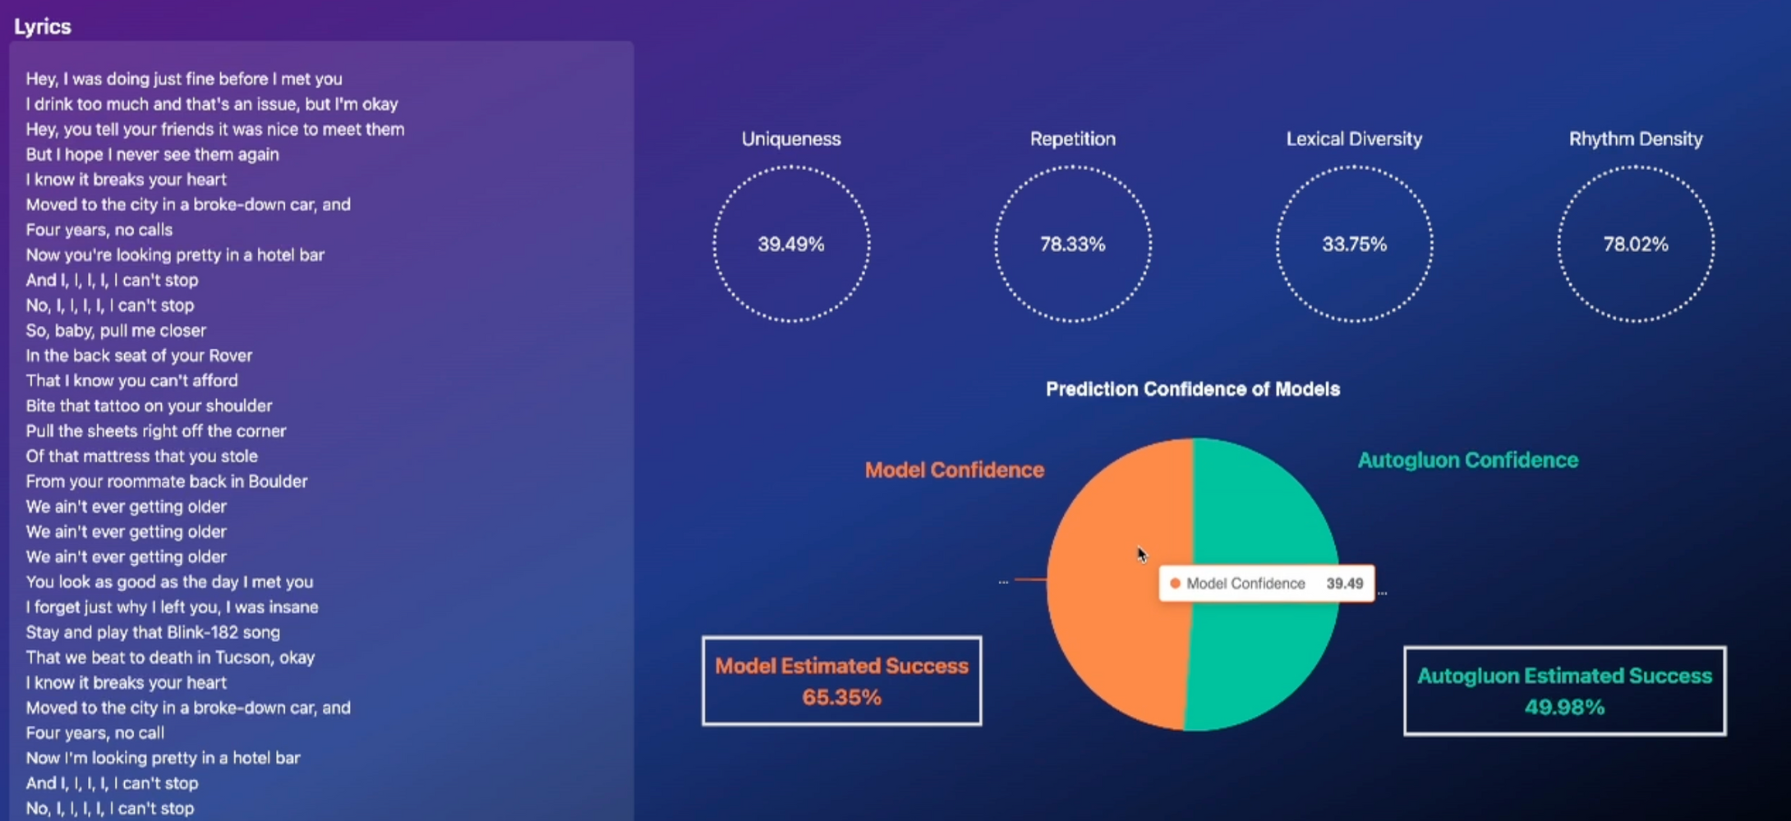

Slide 17
Reference
Can Song Lyrics Predict Hits 🔗

